Slide 1
Maxime Willems
www.proef.club

Slide 2
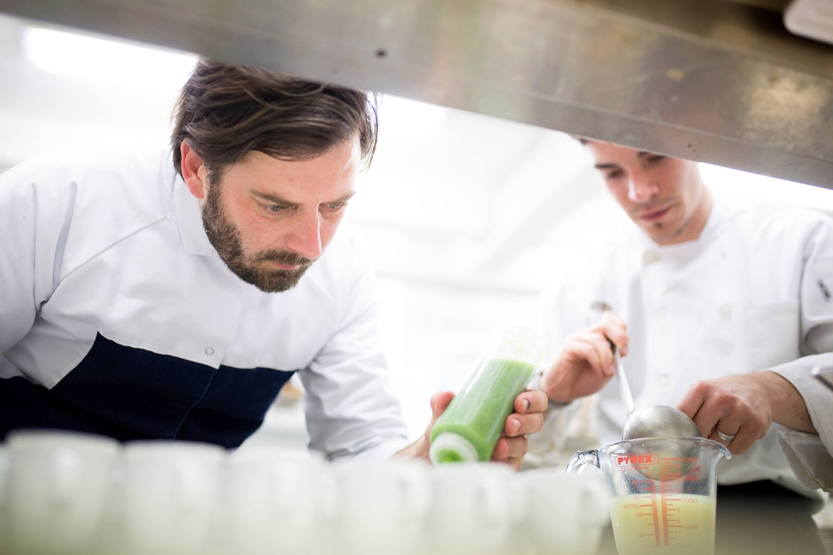
Who am I?

Slide 3
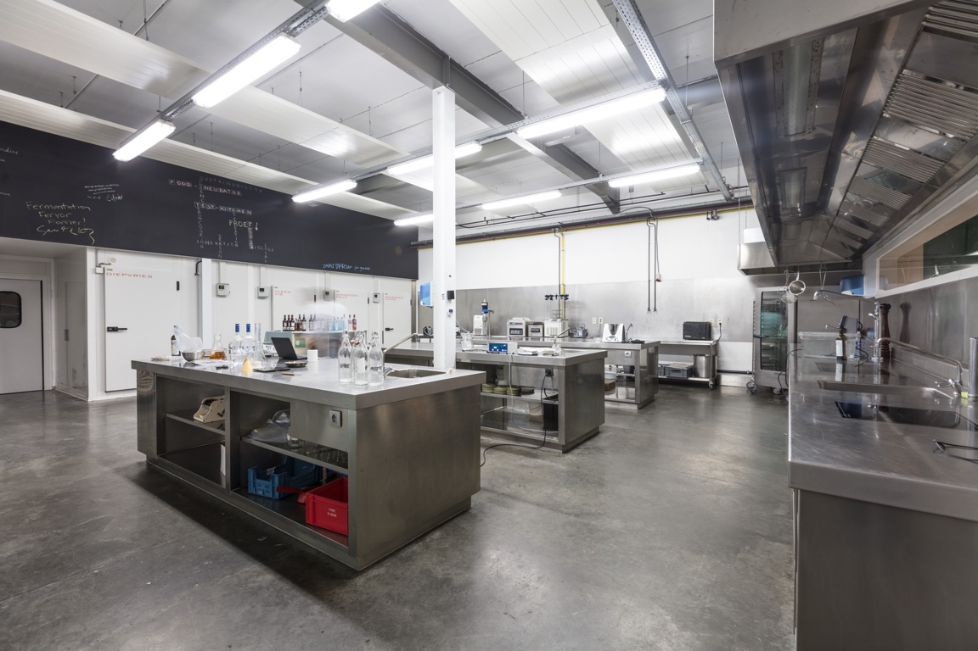
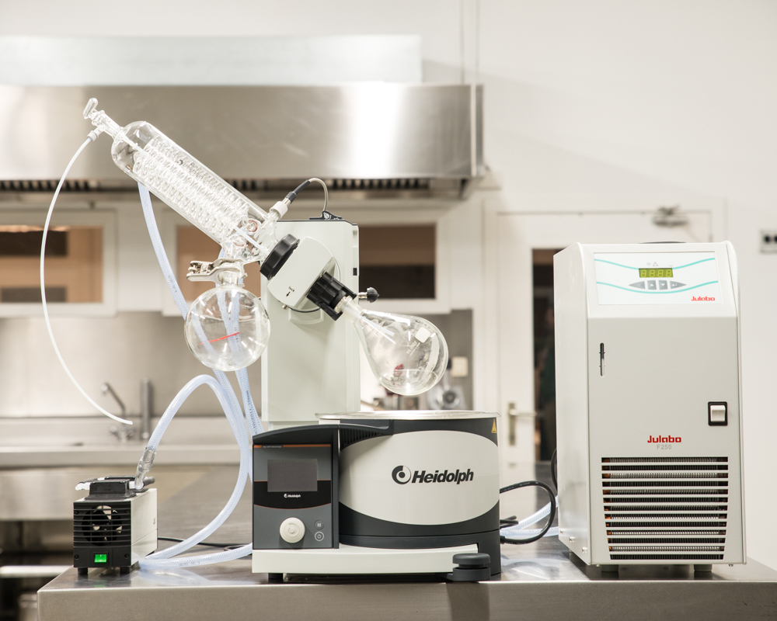
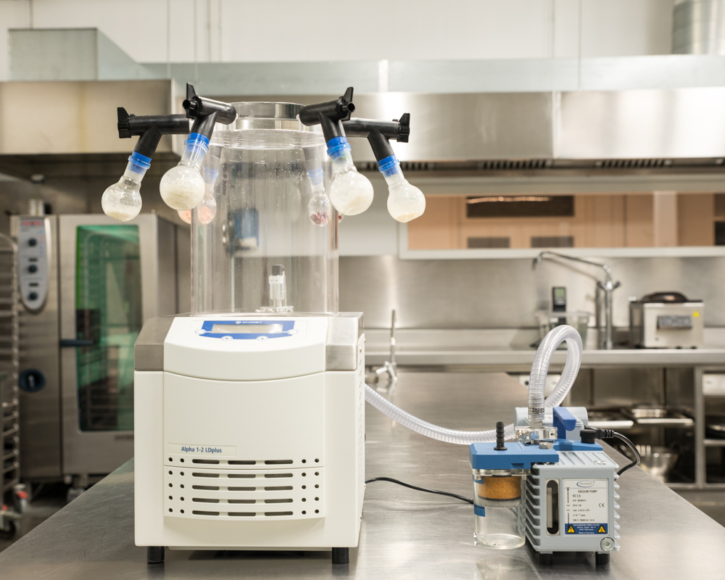
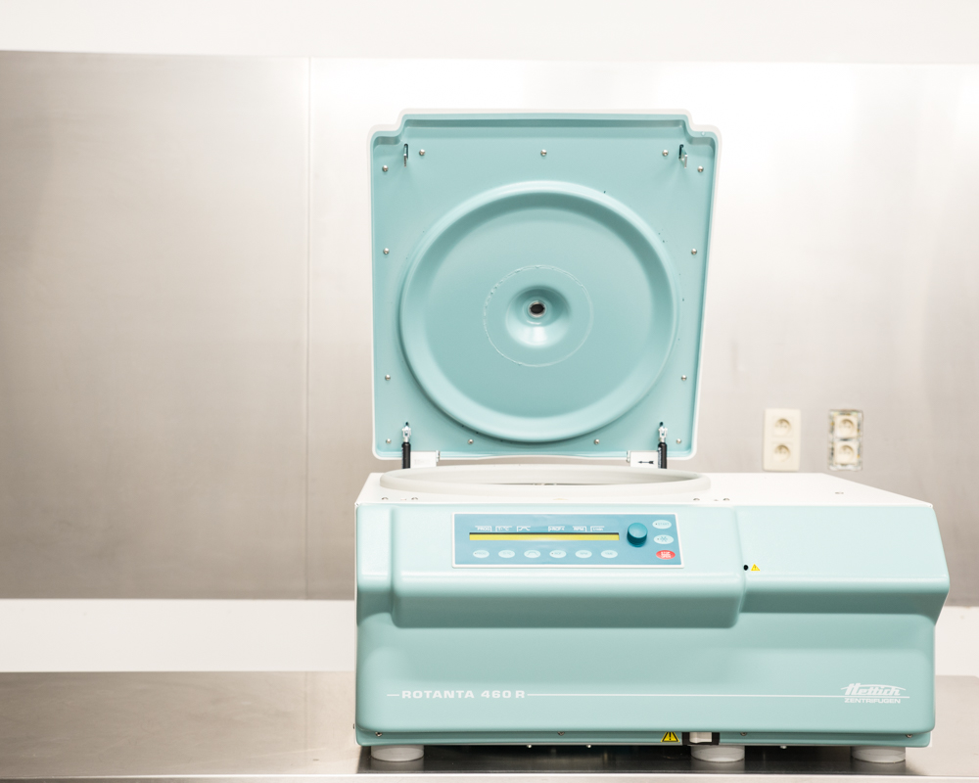
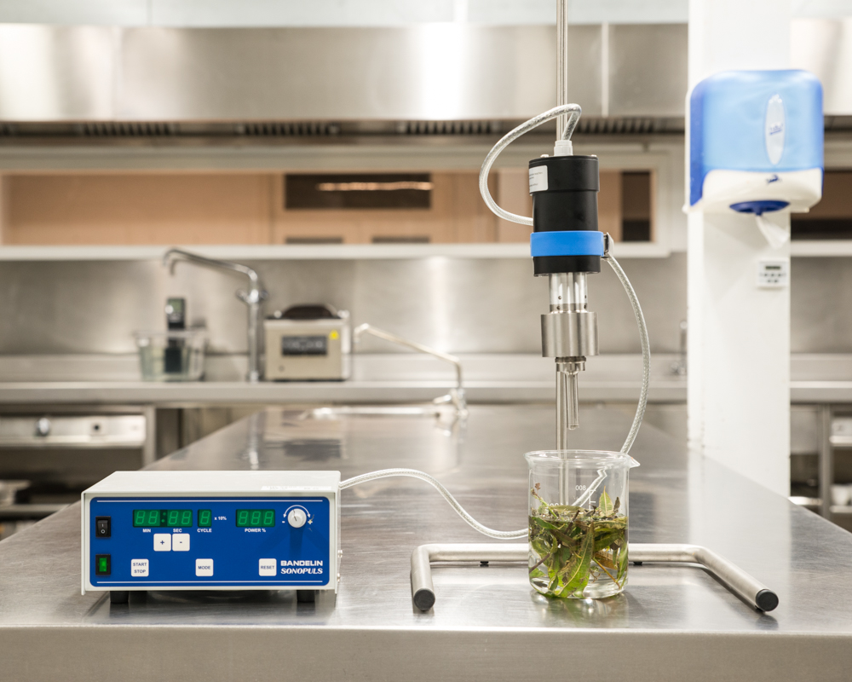
Foodlab & Incubator

Slide 4
What we do

Slide 5
Product Development
from A-Z

Slide 6
Concept definition
Launch
tech blueprint
product DNA
Prototyping
QUAL TEST
+ Guinea Pig members
Recipe Development
Taste Tests
Shelf life
Nutrition
Legal - Claims
Label
App File
Tech File
Project MGMT
Process & Production
Reporting
Comm MGMT
Meet-ups
Ingredient sourcing
Producer
Packaging
Prod File
App on prod site
TEST LAB

Slide 7
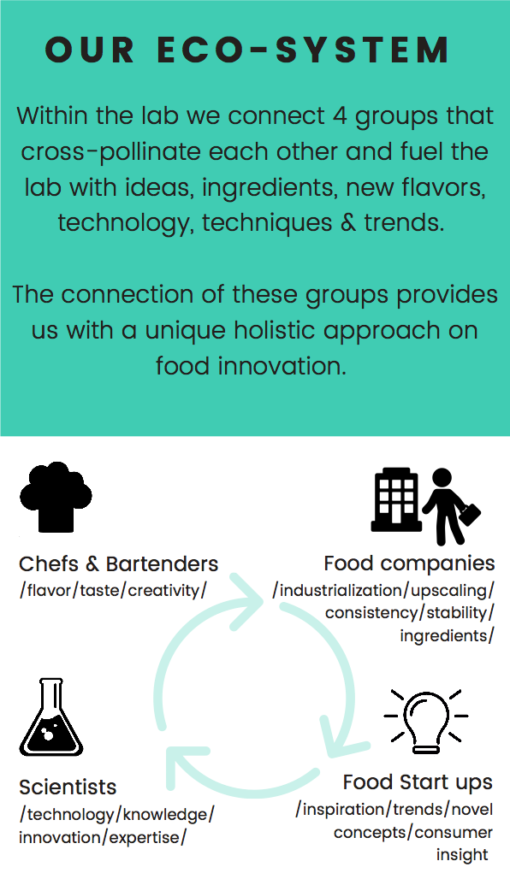

Slide 9
Davai Journey

Slide 10
Ezz drinks

Slide 11
Proef family
Tips Tricks community
Family Journey
Press
Retail
Investors

